Slide 1
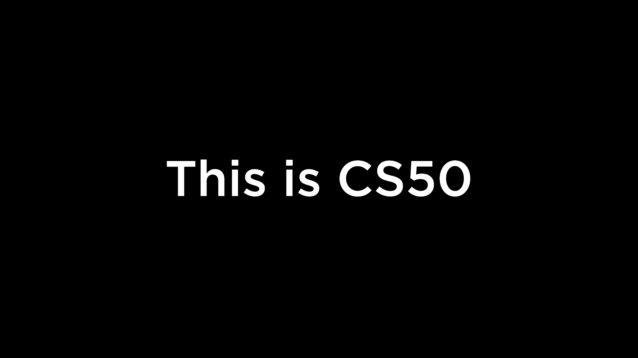

Slide 2
This is CS50
Visit cs50.ly/screen to view projector on your laptop and ask questions via chat.
On today's menu, fruit roll-ups!
If you'd like to stroll to (free) CS50 Lunch after lecture, RSVP at cs50.ly/lunch!
Do say hi or ask questions (or ask for stress ball 🔴) during break or after class!
Will start in just a bit! Sorry almost ready!! Okay now ready. 0:-)

Slide 4
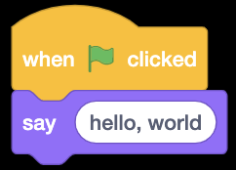

Slide 5
#include <stdio.h>
int main(void) {
printf("hello, world\n");
}

Slide 6
print("hello, world")

Slide 7
make hello
./hello

Slide 8
clang -o hello hello.c -lcs50
./hello

Slide 9
python hello.py
Notes:
1/hello0.py
6/speller/dictionary.py
6/filter/{blur,edges}.py
6/faces/{detect,recognize}.py

Slide 10
functions

Slide 12

printf("hello, world");
Notes:
https://scratchblocks.github.io/#?style=scratch3&script=say%20%5Bhello%2C%20world%5D

Slide 13
printf("hello, world\n");;

Slide 14
print("hello, world");

Slide 15
libraries

Slide 16
#include <cs50.h>

Slide 17
import cs50

Slide 18
from cs50 import get_string

Slide 19
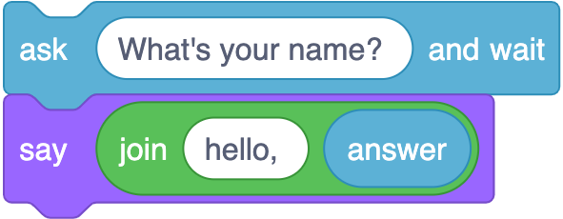
string answer = get_string("What's your name?\n");
printf("hello, %s\n", answer);
Notes:
https://scratchblocks.github.io/#?style=scratch3&script=ask%20%5BWhat's%20your%20name%3F%20%5D%20and%20wait%0Asay%20(join%5Bhello%2C%20%5D%20(answer)%0A

Slide 20
string answer = get_string("What's your name? ");
printf("hello, %s\n", answer);

Slide 21
answer = get_string("What's your name? ")
print("hello, " + answer)

Slide 22
answer = get_string("What's your name? ")
print("hello,", answer)

Slide 23
answer = get_string("What's your name? ")
print(f"hello, {answer}")

Slide 24
answer = input("What's your name? ")
print(f"hello, {answer}")
Notes:
hello{1,2,3}.py

Slide 25
variables

Slide 26
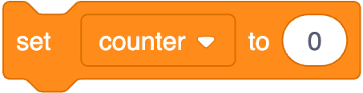
int counter = 0;
Notes:
https://scratchblocks.github.io/#?style=scratch3&script=set%20%5Bcounter%20v%5D%20to%20(0)

Slide 27
int counter = 0;

Slide 28
counter = 0

Slide 29
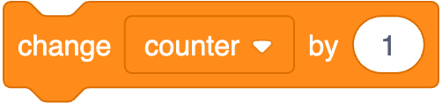
counter = counter + 1;
Notes:
https://scratchblocks.github.io/#?style=scratch3&script=change%20%5Bcounter%20v%5D%20by%20(1)

Slide 30
counter = counter + 1;

Slide 31
counter = counter + 1

Slide 32
counter += 1

Slide 33
types

Slide 34
bool
char
double
float
int
long
string
...

Slide 35
bool
float
int
str
...
Notes:
calculator{0,1}.py

Slide 36
range sequence of numbers
list sequence of mutable values
tuple sequence of immutable values
dict collection of key-value pairs
set collection of unique values
...

Slide 37
range sequence of numbers
list sequence of mutable values
tuple sequence of immutable values
dict collection of key-value pairs
set collection of unique values
...

Slide 38
get_char
get_double
get_float
get_int
get_long
get_string
...

Slide 39
get_float
get_int
get_string

Slide 40
from cs50 import get_float from cs50 import get_int from cs50 import get_string

Slide 41
from cs50 import get_float, get_int, get_string

Slide 42
conditionals

Slide 43
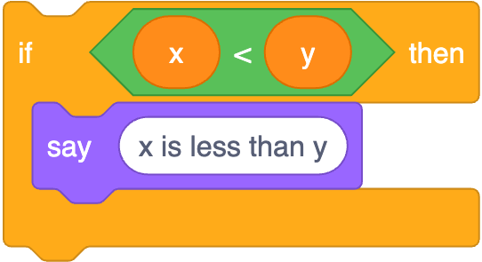
if (x < y) {
printf("x is less than y\n");
}
Notes:
https://scratchblocks.github.io/#?style=scratch3&script=if%20%3C(x)%20%3C%20(y)%3E%20then%0Asay%20%5Bx%20is%20less%20than%20y%5D

Slide 44
if (x < y) {
printf("x is less than y\n");
}

Slide 45
if x < y:
print("x is less than y")

Slide 46
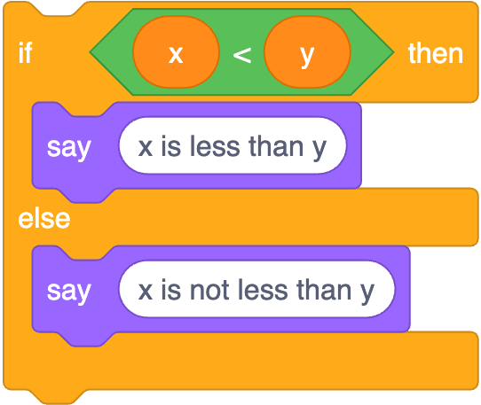
if (x < y) {
printf("x is less than y\n");
}
else
{ printf("x is not less than y\n");
}
Notes:
https://scratchblocks.github.io/#?style=scratch3&script=if%20%3C(x)%20%3C%20(y)%3E%20then%0Asay%20%5Bx%20is%20less%20than%20y%5D%0Aelse%0Asay%20%5Bx%20is%20not%20less%20than%20y%5D

Slide 47
if (x < y) {
printf("x is less than y\n");
}
else
{ printf("x is not less than y\n");
}

Slide 48
if x < y:
print("x is less than y")
else: print("x is not less than y")

Slide 49
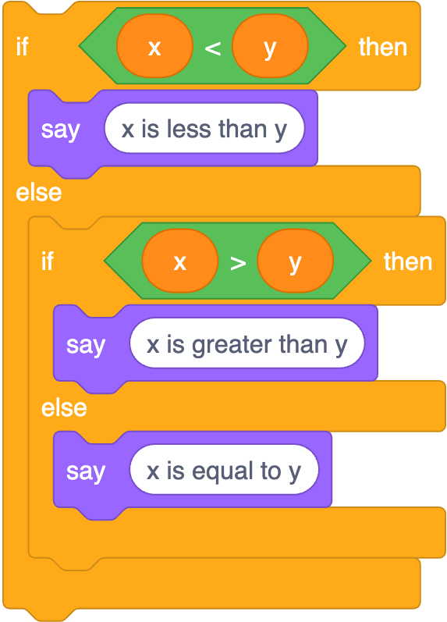
if (x < y) {
printf("x is less than y\n");
}
else if (x > y)
{ printf("x is greater than y\n");
}
else
{ printf("x is equal to y\n");
}
Notes:
https://scratchblocks.github.io/#?style=scratch3&script=if%20%3C(x)%20%3C%20(y)%3E%20then%0Asay%20%5Bx%20is%20less%20than%20y%5D%0Aelse%0Aif%20%3C(x)%20%3E%20(y)%3E%20then%0Asay%20%5Bx%20is%20greater%20than%20y%5D%0Aelse%0Asay%20%5Bx%20is%20equal%20to%20y%5D

Slide 50
if (x < y) {
printf("x is less than y\n");
}
else if (x > y)
{ printf("x is greater than y\n");
}
else
{ printf("x is equal to y\n");
}

Slide 51
if x < y:
print("x is less than y")
elif x > y: print("x is greater than y")
else: print("x is equal to y")
Notes:
1/compare3.py

Slide 52
str
Notes:
4/compare.py
1/agree{0,1}.py

Slide 53
object-oriented programming

Slide 54
OOP

Slide 55
docs.python.org/3/library/stdtypes.html#string-methods
Objects can have both values and functions
a method is a function that belongs to some data type eg string
Notes:
1/agree2.py
4/copy.py
2/uppercase{0,1}.py

Slide 56
docs.python.org/3/library/functions.html

Slide 57
docs.python.org

Slide 58
loops

Slide 59
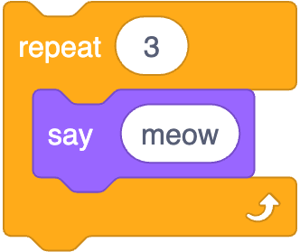
int i = 0;
while (i < 3)
{
printf("meow\n");
i++;
}
Notes:
https://scratchblocks.github.io/#?style=scratch3&script=repeat%20%5B3%5D%0Asay%5Bmeow%5D

Slide 60
int i = 0;
while (i < 3)
{
printf("meow\n");
i++;
}

Slide 61
i = 0
while i < 3:
print("meow")
i += 1

Slide 62
for (int i = 0; i < 3; i++)
{
printf("meow\n");
}

Slide 63
for (int i = 0; i < 3; i++)
{
printf("meow\n");
}

Slide 64
for i in [0, 1, 2]:
print("hello, world")

Slide 65
for i in range(3):
print("hello, world")

Slide 66
for _ in range(3):
print("hello, world")

Slide 67
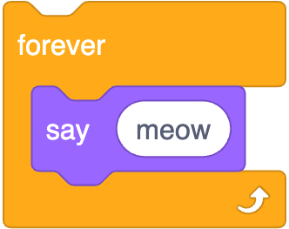
while (true)
{
printf("meow\n");
}
Notes:
https://scratchblocks.github.io/#?style=scratch3&script=forever%0Asay%5Bmeow%5D

Slide 68
while (true)
{
printf("meow\n");
}

Slide 69
while True:
print("meow")
Notes:
meow{0,1,2,3,4,5}.py

Slide 70
named parameters

Slide 71
positional parameters

Slide 72
break

Slide 73
while True:
print("meow")
Notes:
meow{0,1,2,3,4,5}.py

Slide 74
truncation
Notes:
calculator2.py, with 1/3

Slide 75
floating-point imprecision
Python has 3rd party libraries that offer greater precision for scientific purposes
Notes:
calculator3.py, with 1/3

Slide 76
integer overflow
not a problem in latest Python
more memory is dynamically allocated as needed

Slide 77
integer overflow

Slide 78
exceptions
Notes:
calculator{4,5}.py

Slide 79
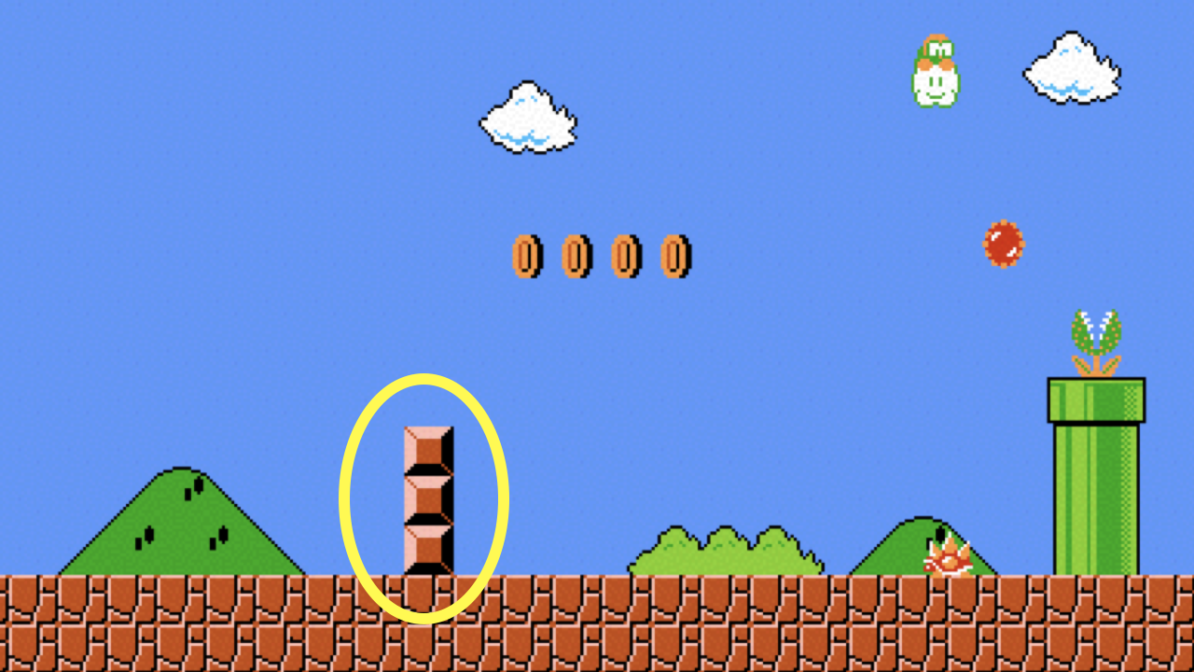
Notes:
mario{0,1,2,3}.py

Slide 80
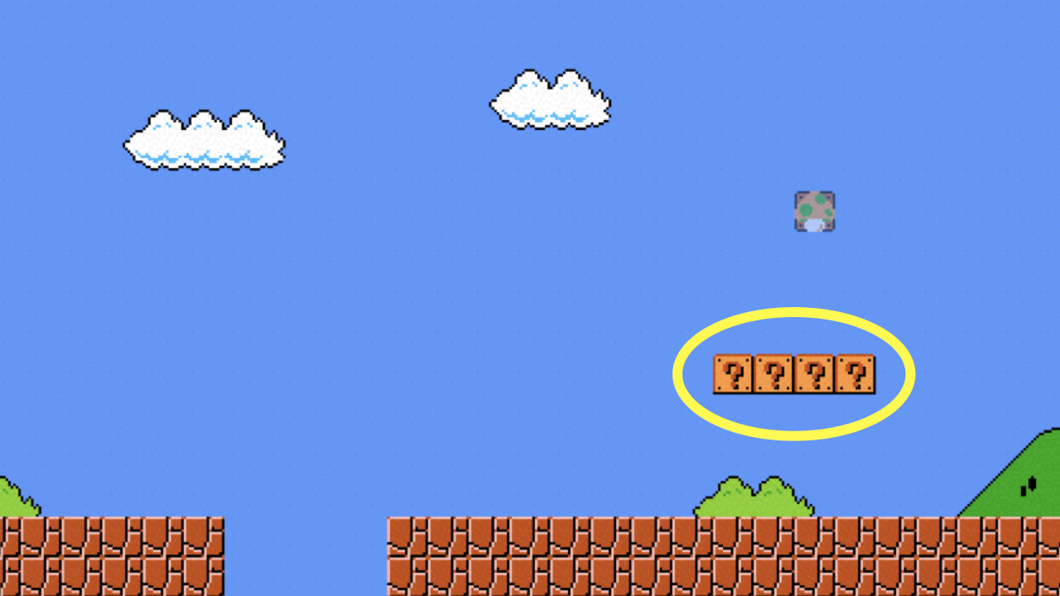

Slide 81
print

Slide 82
docs.python.org/3/library/functions.html#print
Notes:
mario{4,5}.py

Slide 83
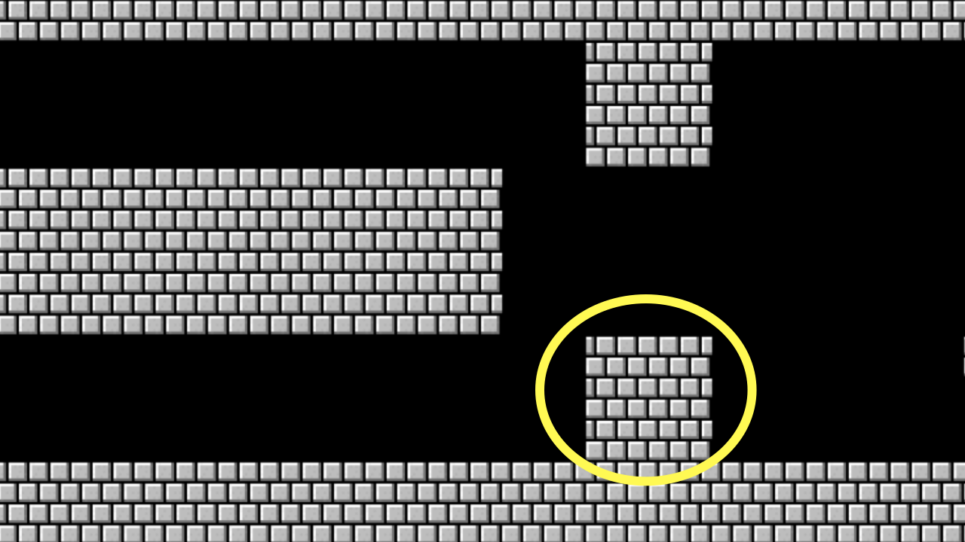
Notes:
mario{6,7}.py

Slide 84
list

Slide 85
docs.python.org/3/library/stdtypes.html#sequence-types-list-tuple-range

Slide 86
len

Slide 87
docs.python.org/3/library/functions.html#len
Notes:
2/scores{0,1,2}.py
3/phonebook{0,1}.py

Slide 88
dict
Python’s hash table

Slide 89
key | value

Slide 90
docs.python.org/3/library/stdtypes.html#mapping-types-dict
Notes:
phonebook{2,3,4}.py

Slide 91
sys

Slide 92
docs.python.org/3/library/sys.html
Notes:
2/greet{0,1,2}.py
2/exit.py

Slide 93
csv

Slide 94
docs.python.org/3/library/csv.html
Notes:
4/phonebook{0,1,2}.py

Slide 95
pip

Slide 96
come on up for stress ball if you'd like

